Slide 1
Sprint #3
By Team [Hip, Hip]: Jack, Alea, and Elizabeth

Slide 2
Overview
User Story extensions
Changes to code
Quality of life Improvement
Form optimization methods
Design/user experience improvements
Button logic, etc.
We will be talking about…

Slide 3
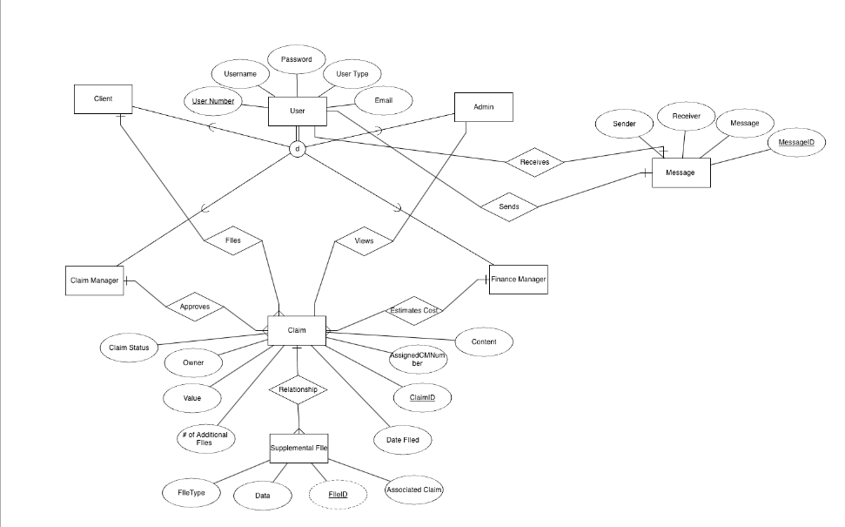
Updated ERD

Slide 4
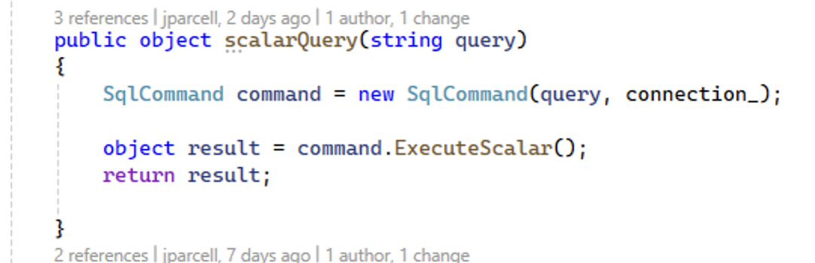
Code Examples
Added a query to return any type of variable

Slide 5
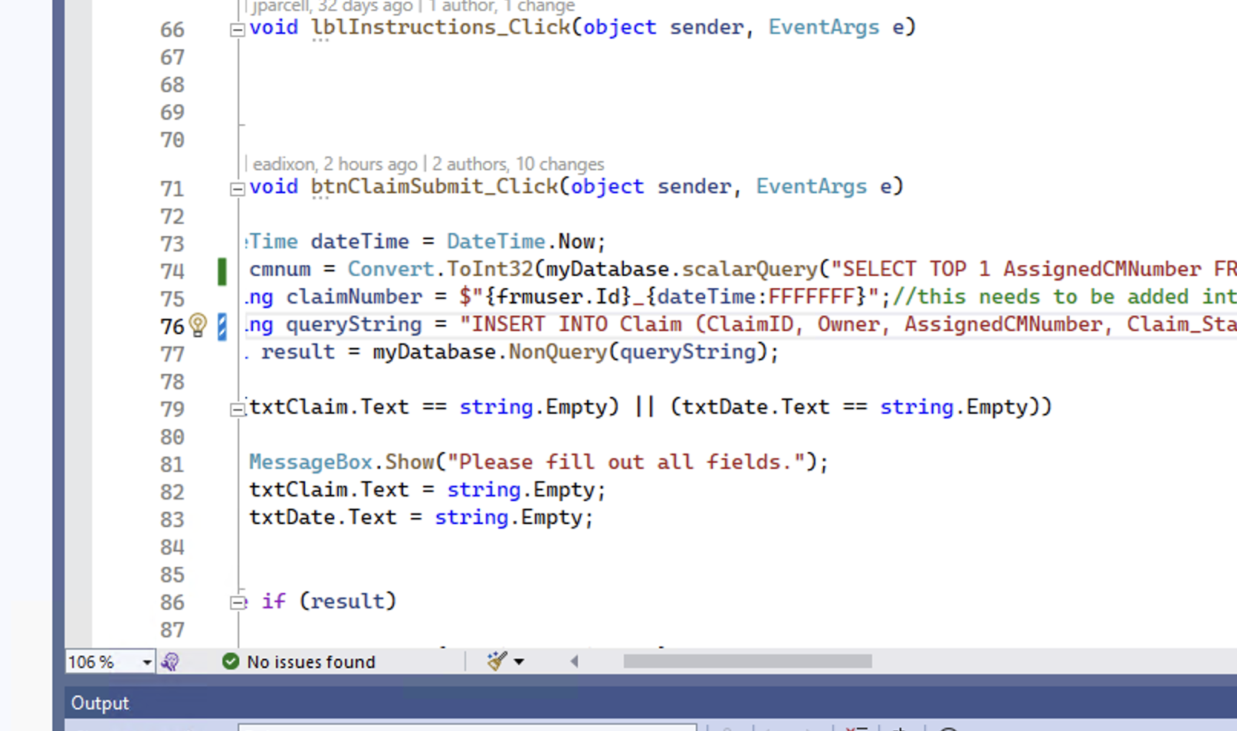
This is an example of adding a claim to the database

Slide 6
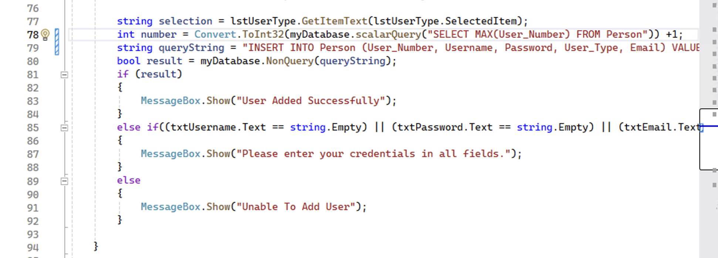
This is an example of adding a person to the database.

Slide 7

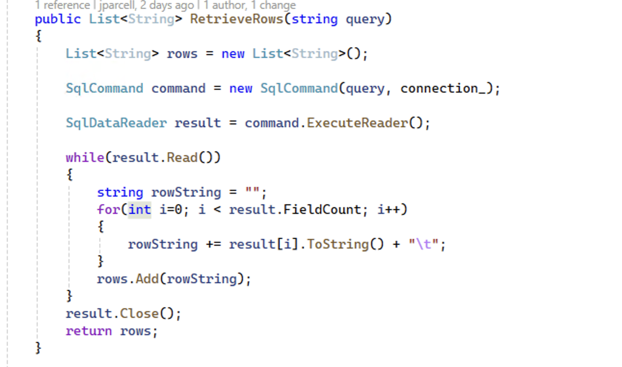
This is an example of the query that return the claims and maybe the messages later on

Slide 8
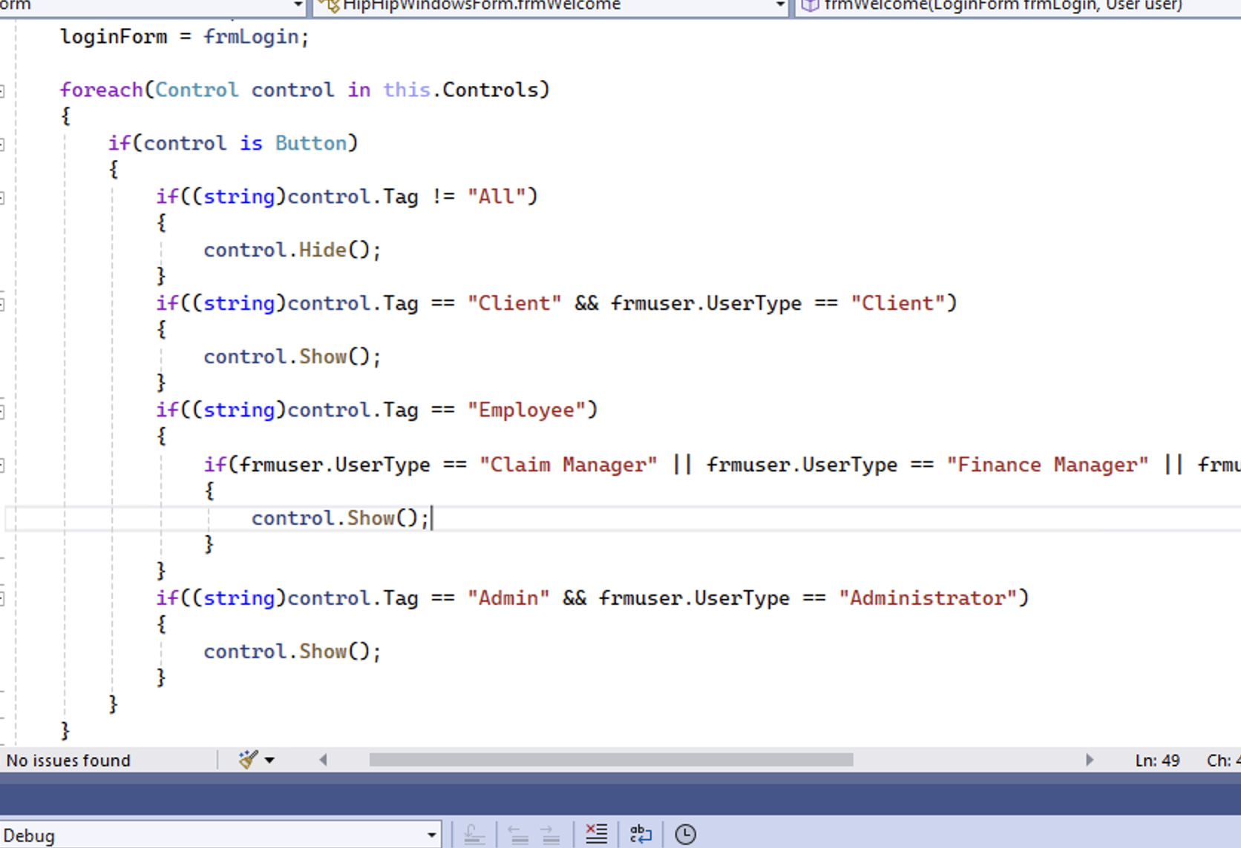
Different homepages depending on user type

Slide 9
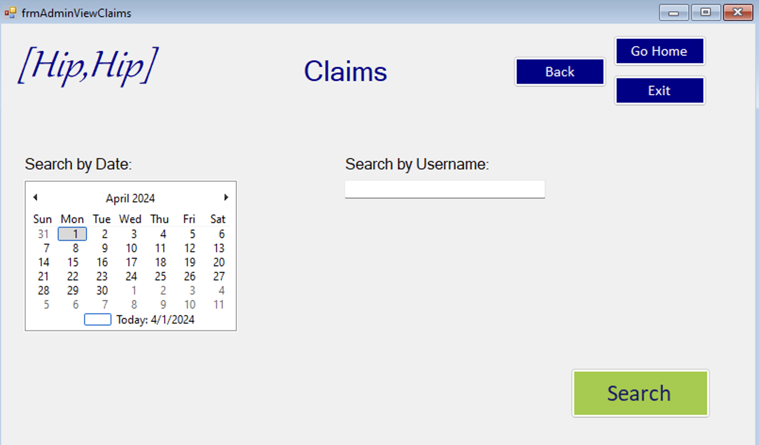
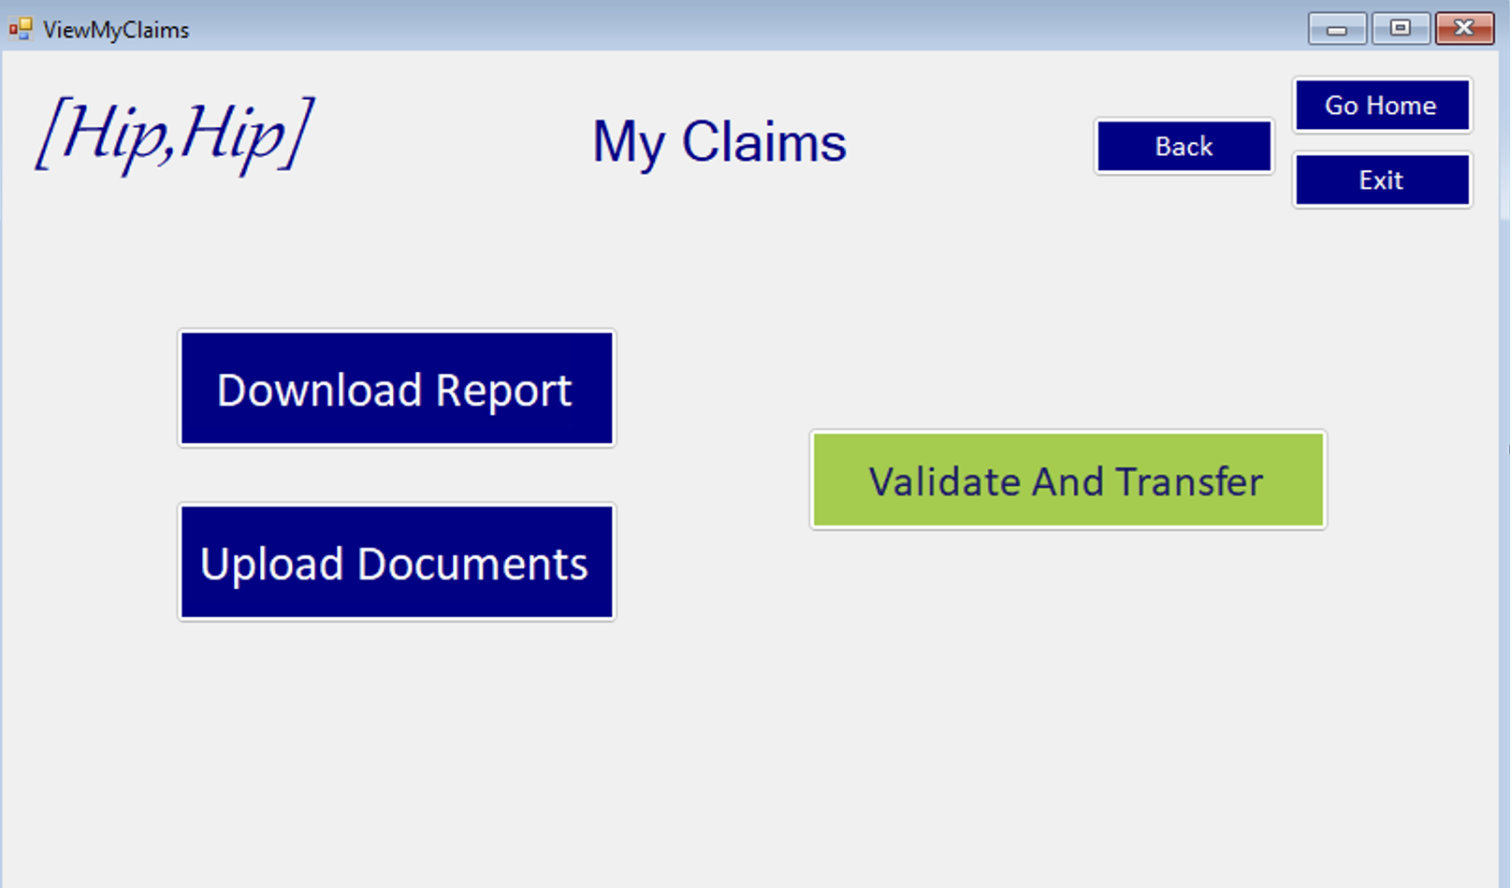
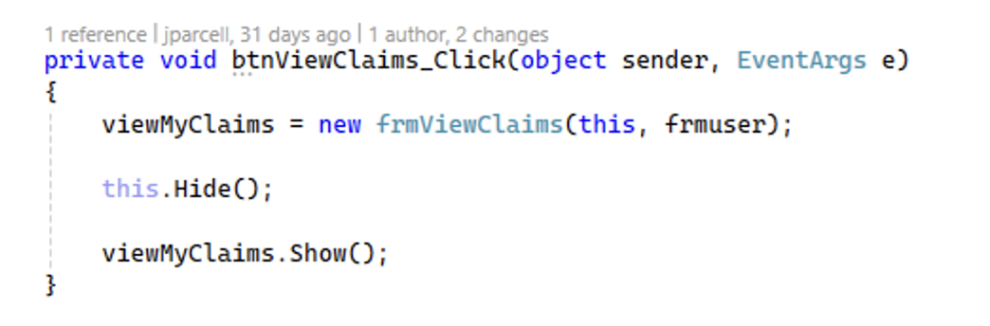
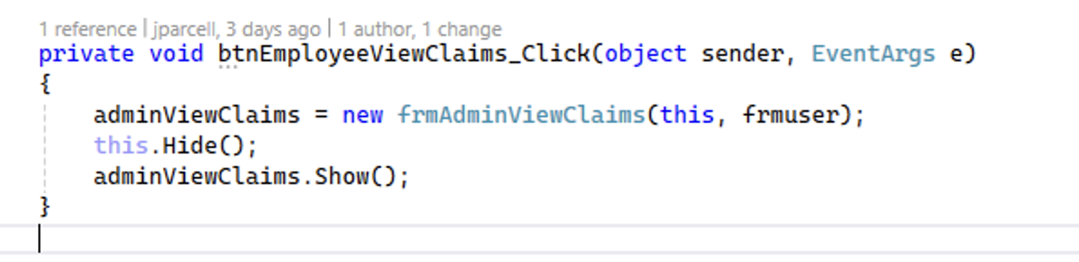
Employee vs. Client Claim View

Slide 10
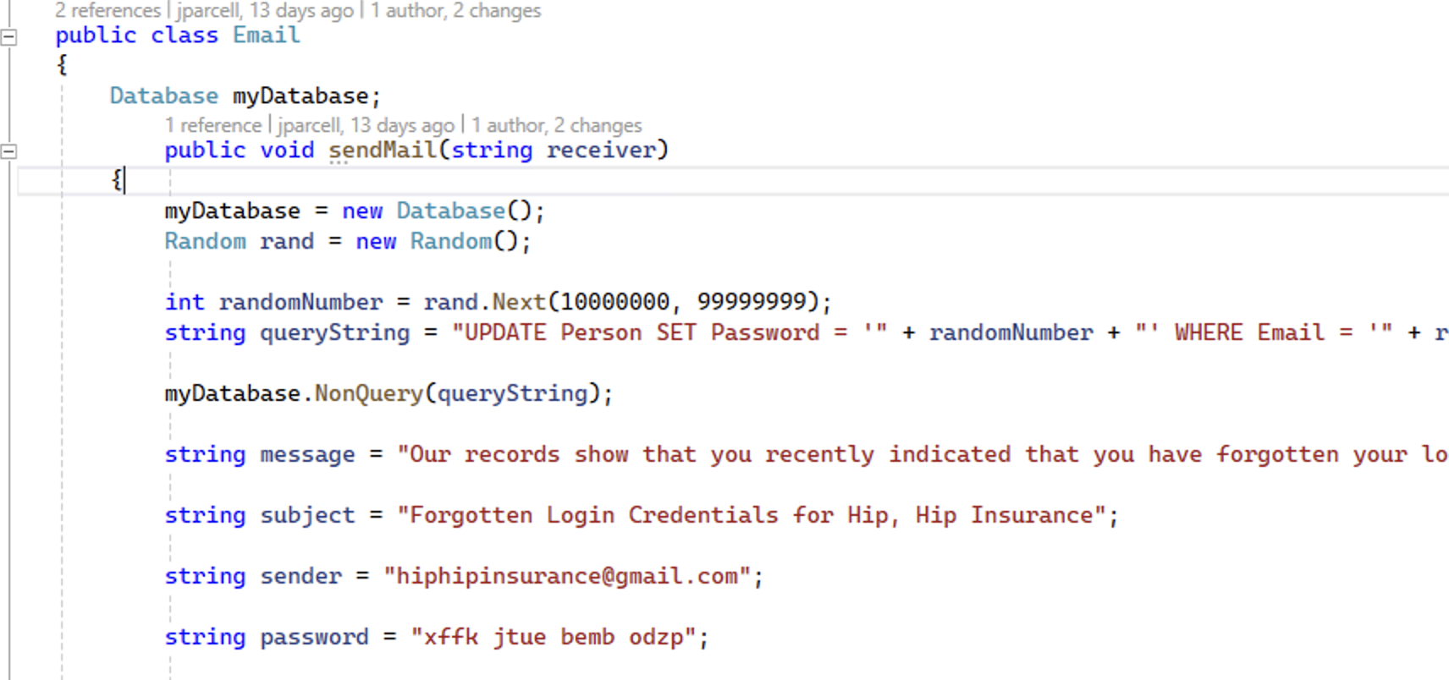

Slide 11
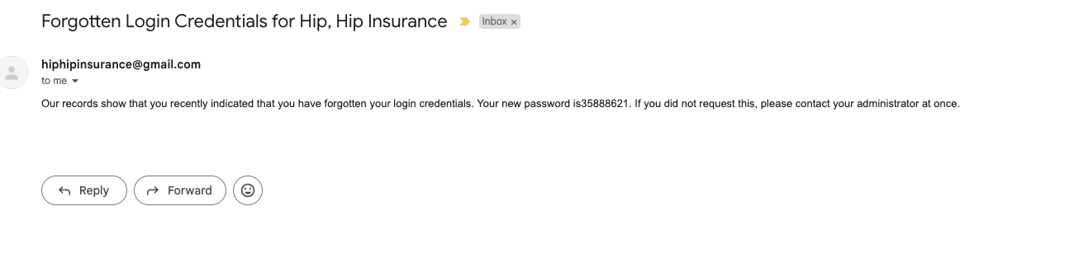
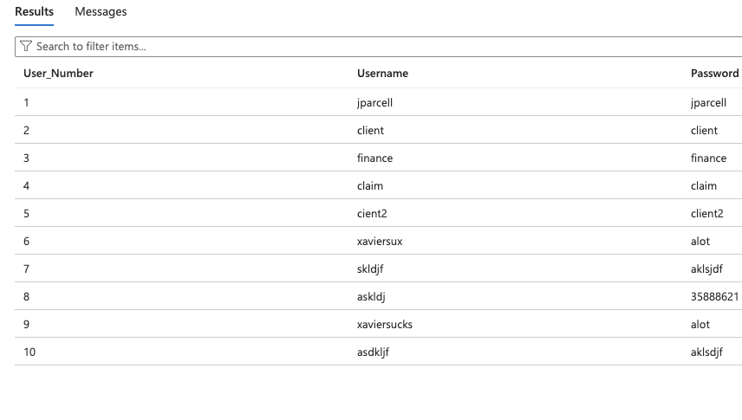

Slide 12
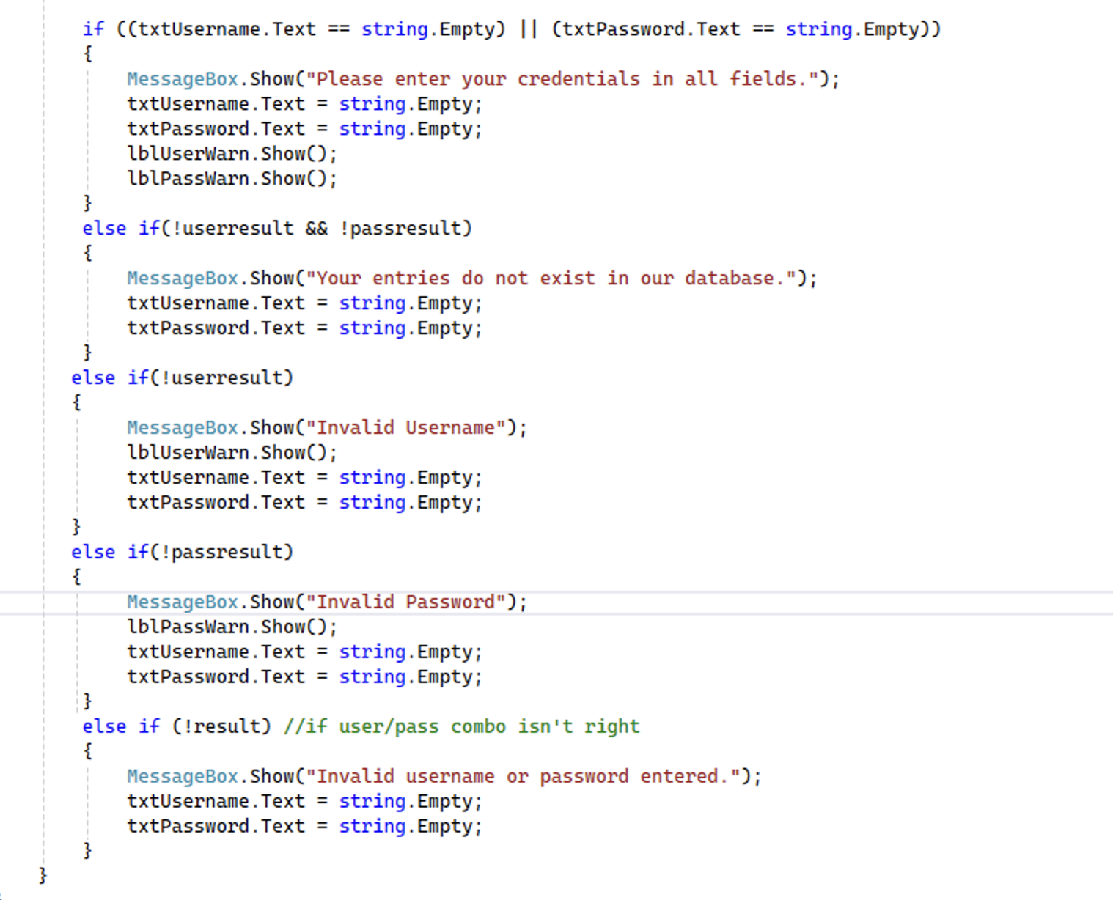

Slide 13
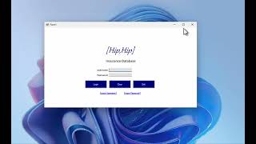
Button/Field Logic Improvement Demo

Slide 14
Challenges
Correctly formatting search results
Formatting forms after new method
Handling exceptions
Fixing w/ correct logic
Team issues

Slide 15
What's Next?
Implement messaging functionality
Make the inboxes make sense for each user story, too
Allow user to upload and download files
Claim Manager and Finance Manager can work on claims (Approving, valuing, etc)
Handling exceptions on “confirm” buttons
Clean up formatting
Ideas for Sprint #4…

